Slide 1
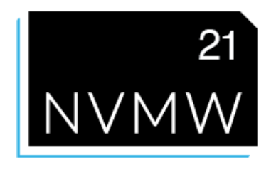


CrossFS: A Cross-layered Direct-Access File System
Yujie Ren¹, Changwoo Min², and Sudarsun Kannan¹
¹ Rutgers University; ² Virginia Tech
Notes:
Good morning everyone, my name is Yujie Ren. today I’ll be presenting our work: CrossFS: A Cross-layered Direct Access File System. This work is done in cooperation with Changwoo Min and Sudarsun Kannan.

Slide 2
Outline
Background
Motivation
Design
Evaluation
Conclusion

Slide 3

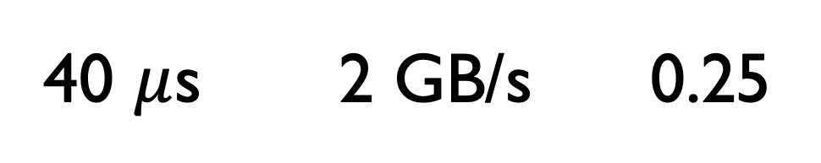
Modern Storage Devices
In-storage compute is powerful
Latency B/W $/GB
Volatile
DRAM
None-Volatile
300 ns 10 GB/s 4.0
NVM
40 $μ$s 2 GB/s 0.25
Ultra-fast SSD
5 ms 2.6 MB/s 0.02
HDD
Notes:
Similar to the well-known memory hierarchy from processor cache to DRAM, now the storage is also becoming hierarchical. With the advent of new storage technologies such as ultra-fast SSD and nonvolatile memory technologies like 3D Xpoint, the storage technology has finally entered the microsecond era.

Slide 4
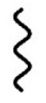
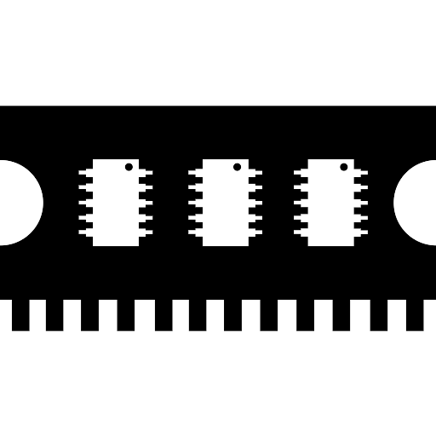
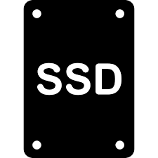

I/O Software Overheads
Application
Application
Increasing thread and process-level concurrency critical!
Reducing file system software cost is critical
write(file1)
write(file1)
VFS Layer
Actual FS
Page Cache
PMFS
ext4
Block I/O Layer
: Kernel Trap
Device Driver
: OS Overhead
OS Kernel
Notes:
As storage hardware has higher bandwidth and low latency, now the bottleneck has shifted from hardware to software. To access a file on storage, an application need to issue a system call trap into OS kernel. There are several layers along I/O subsystem in the Linux kernel, VFS layer, actual file system, page cache, Block I/O layer, then device driver. And finally reaching the storage, hard disk, SSD or NVM. During the above process, three types of software overheads dominates: Kernel trap, Data copy and other OS overheads such as locking in OS. For example, when that application issues a write system call, it first trap into OS kernel, copy the data to kernel space, then the VFS layer will route to the actual file system, if that is block device with ext4 file system, it will go through page cache, BIO, device driver, then hardware. For memory-like byte-addressable storage like NVM, special FS like PMFS go update-in-place without going through page cache etc. I/O system call takes around 1-4 micro sec depending on system call type and data size.

Slide 5
State-of-the-art Designs
Kernel-FS
User-FS
Firmware-FS
Application
Application
Application
FS Lib
FS Lib
Kernel FS
Trusted FS Server
Firmware FS
Storage
Storage
Storage
ext4-DAX
NOVA (FAST’ 16)
Strata (SOSP’ 17)
SplitFS (SOSP’ 19)
DevFS (FAST’ 18)
Insider (ATC’ 19)
: data-plane ops
: control-plane ops
Notes:
There are roughly three categories of file systems. Kernel-FS is a traditional file systems that lays in the OS kernel manages both data and meta-data, it provides security and crash consisteny but the system call overheads is …. User-FS disaggregate data-plane operations and control-plane operations where data-plane operations are bypassing os kernel, but control plane operations need OS TRAP. Firmware-FS takes a radical approach that offloading the entire file sysetm copmonents to storage firmaware to provde direct access.

Slide 6
Outline
Background
Motivation
Design
Evaluation
Conclusion

Slide 7

Design Classes Summary
Classes | File System | Direct-Access | Utilize Host CPU | Utilize Storage CPU | Fine-grained Concurrency
Kernel-FS | ext4-DAX
User-FS | SplitFS
Firmware-FS | DevFS
Cross-FS | CrossFS
Satisfy
Partially satisfy
Not satisfy
Ideal for achieving higher performance
More file systems discussed in the paper
Notes:
With the advent of new storage technologies such as NVMe and other nonvolatile memory technologies such as 3D Xpoint, the storage technology has finally entered the microsecond era. Modern NVM technologies can provide up to 4 times higher bandwidth and eight times lower hardware latency. However, the software bottlenecks remain, in fact doubling the hardware latency. The applications interact with the OS (i.e.,) context switch and multiple layers of I/O subsystem in OS dominates the software overhead. As a result, the bottlenecks have shifted from hardware to software.

Slide 8



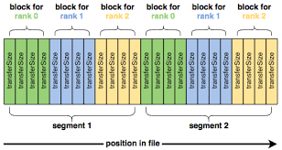
Need for Fine-grained Concurrency
Several apps. share files across writers (producers) and readers (consumers)
IOR
Notes:
Concurrency is critical in several datacenter and HPC applications and widely-used benchmarks that shard files across threads and processes

Slide 9



Concurrency Analysis
Two threads write to disjoint blocks of a shared file
App Thread 1
App Thread 2
write(shared_file, Block 2)
write(shared_file, Block N)
File System
inode
Coarse-gained per-inode locks for disjoint blocks!
Block 1
Block 2
Block 3
…
Block N
Shared file
Notes:
Besides the high overhead in current file systems, scalability is also a problem with state-of-the-art file systems as the CPU cores are more and more. Concurrent access is also a bottleneck in current file systems. When multiple threads/processes writes to the same file even with different block, then entire file is locked, the second thread need to wait until the first thread release the lock

Slide 10
Concurrency Analysis
Concurrent reader and writer threads randomly accessing a shared file
Inode-level locking is the bottleneck!
X-axis shows # of reader threads
Y-axis shows the aggregated throughput
Notes:
With the advent of new storage technologies such as NVMe and other nonvolatile memory technologies such as 3D Xpoint, the storage technology has finally entered the microsecond era. Modern NVM technologies can provide up to 4 times higher bandwidth and eight times lower hardware latency. However, the software bottlenecks remain, in fact doubling the hardware latency. The applications interact with the OS (i.e.,) context switch and multiple layers of I/O subsystem in OS dominates the software overhead. As a result, the bottlenecks have shifted from hardware to software.

Slide 11
Outline
Background
Motivation
Design
Evaluation
Conclusion

Slide 12
Our Solution: CrossFS
A cross-layered direct-access file system
Disaggregated FS components to exploit host and device CPUs
OS-bypass for data-plane and control-plane operations
File descriptor-based fine-grained concurrency control
Firmware-level file descriptor’s I/O queue scheduling
Cross-layered crash consistency
Please see our paper in OSDI’ 20
Notes:
With the advent of new storage technologies such as NVMe and other nonvolatile memory technologies such as 3D Xpoint, the storage technology has finally entered the microsecond era. Modern NVM technologies can provide up to 4 times higher bandwidth and eight times lower hardware latency. However, the software bottlenecks remain, in fact doubling the hardware latency. The applications interact with the OS (i.e.,) context switch and multiple layers of I/O subsystem in OS dominates the software overhead. As a result, the bottlenecks have shifted from hardware to software.

Slide 13
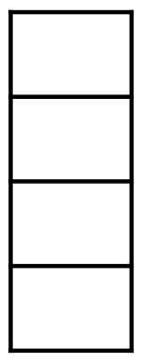
CrossFS Components
Application
Support POSIX semantics
Add I/O commands to I/O queue
Handle Concurrency control
LibFS
Host CPUs
Handle FS mount and setup
Help with security
Kernel Component
I/O queues
Handle I/O request scheduling
Manage Data and metadata
Support Journaling
Perform Permission checks
FirmFS
Device CPUs
Storage
: data-plane ops
: control-plane ops
Notes:
With the advent of new storage technologies such as NVMe and other nonvolatile memory technologies such as 3D Xpoint, the storage technology has finally entered the microsecond era. Modern NVM technologies can provide up to 4 times higher bandwidth and eight times lower hardware latency. However, the software bottlenecks remain, in fact doubling the hardware latency. The applications interact with the OS (i.e.,) context switch and multiple layers of I/O subsystem in OS dominates the software overhead. As a result, the bottlenecks have shifted from hardware to software.

Slide 14
Fine-grained Concurrency Control
Inode-level rw-lock is the bottleneck
- Even non-overlapping reads and writes are serialized
Non-overlapping writes could be parallelized
- Different threads could open different file descriptors for a shared file
Thread 1
fd1 = open(“shared_file”, rw);
pwrite(fd1, buf, sz=4096, off=0);
Thread 2
fd2 = open(“shared_file”, rw);
pwrite(fd2, buf, sz=4096, off=8192);
File descriptor is a natural concurrency abstraction
Independent file descriptors for a shared file
Map each file descriptor to an independent hardware I/O queue
Notes:
With the advent of new storage technologies such as NVMe and other nonvolatile memory technologies such as 3D Xpoint, the storage technology has finally entered the microsecond era. Modern NVM technologies can provide up to 4 times higher bandwidth and eight times lower hardware latency. However, the software bottlenecks remain, in fact doubling the hardware latency. The applications interact with the OS (i.e.,) context switch and multiple layers of I/O subsystem in OS dominates the software overhead. As a result, the bottlenecks have shifted from hardware to software.

Slide 15
Fine-grained Concurrency Control
Align each file descriptor to a dedicated I/O queue (FD-queue)
Thread 1
fd1 = open(“shared_file”, rw);
pwrite(fd1, buf, sz = 4096, off = 0);
Thread 2
fd2 = open(“shared_file”, rw);
pwrite(fd2, buf, sz = 4096, off =8192);
LibFS
fd₁ FD-queue
fd₂ FD-queue
Kernel component
Op1
Op2
Concurrent writes on a shared file
NVM
Create FD-queue in DMA-able NVM region
FirmFS

Slide 16
Fine-grained Concurrency Control
What about overlapping concurrent writes?
Thread 1
fd1 = open(“shared_file”, rw);
pwrite(fd1, buf, sz = 4096, off = 0);
Thread 2
fd2 = open(“shared_file”, rw);
pwrite(fd2, buf, sz = 4096, off = 0);
Two threads write to the same/overlapping blocks

Slide 17
Fine-grained Concurrency Control
Resolving overlapping writes – Interval tree data structure
Efficient lookup of overlapping blocks requests across FD-queues
Low
high
[15, 20]
40
Max in subtree
[10, 30]
30
[17, 19]
40
[5, 20]
20
[12, 15]
15
[30, 40]
40
CrossFS uses interval tree to store I/O block ranges for in-flight requests

Slide 18
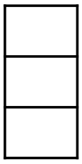
Fine-grained Concurrency Control
Resolving conflict writes – Interval tree structure
Thread 1
fd1 = open(“shared_file”, rw);
Op1: pwrite(fd1, buf, sz=4096, off=0)
Thread 2
fd2 = open(“shared_file”, rw);
Op2: pwrite(fd2, buf, sz=4096, off = 4096)
Op3: pwrite(fd2, buf, sz = 4096, off = 0);
LibFS
[0, 16k]
Interval tree lock
[0, 8k]
[8k, 16k]
Overlapping writes
Locking only required during interval tree lookup, insert and delete
Non-overlapping writes
[0, 4k]
[4k, 8k]
[8k, 12k]
Interval tree unlock
fd₁ FD-queue
fd₂ FD-queue
Kernel component
CrossFS converts file concurrency control to queue ordering problem
Once requests are ordered, FirmFS dispatches requests from queues in parallel
Op1
Op2
Order Op3 in the same queue as Op1 and make Op1 no-op
Op3
NVM
Create FD-queue in DMA-able NVM region

Slide 19
Outline
Background
Motivation
Design
Evaluation
Conclusion

Slide 20
Experimental Setup
Hardware platform
- Dual-socket 64-core Xeon Scalable CPU @ 2.6GHz
- 512GB Intel Optane DC NVM
Emulate firmware-level FS (no programmable storage H/W)
- Reserve dedicated device threads for handling I/O requests
- Add PCIe latency for all I/O operations
- Reduce CPU frequency for device CPUs
State-of-the-art file systems
- ext4-DAX, NOVA [FAST’ 16] (Kernel-level file system)
- Strata [SOSP ‘17], SplitFS [SOSP’ 19] (User-level file system)
- DevFS [FAST’ 18] (Firmware-level file system)

Slide 21
Read Scalability Benchmark
Multiple readers and 4 writer threads accessing a 12GB shared file
4.87x
X-axis: # of concurrent readers
Y-axis: Aggregated readers’ throughput
Readers do not have to wait for writers

Slide 22
Write Scalability Benchmark
Multiple readers and 4 writer threads accessing a 12GB shared file
3.41x
X-axis: # of concurrent readers
Y-axis: Aggregated writers’ throughput
Non-overlapping writes dispatched in parallel

Slide 23
Application - RocksDB
DBbench fillrandom (random write) benchmark
2.27x
More results in our paper!
X-axis: # of DBbench threads
Y-axis: fillrandom benchmark throughput
- RocksDB threads append kv-pairs to shared log files.
- CrossFS eliminates inode-level lock overheads

Slide 24
Conclusion
Storage hardware (with compute capability) has reached the microsecond era
Providing direct I/O and utilizing host and storage-level compute is critical
- Our approach: Cross-layered storage file system design
Fine grained concurrency control is important for I/O scalability
- Our approach: File-descriptor concurrency control
Future work:
- H/W integration, support for sophisticated scheduling policies, other file system operations (e.g., mmap())
Thanks!
yujie.ren@rutgers.edu
https://github.com/RutgersCSSystems/CrossFS

Slide 25
Backup
Notes:
When crash happens, the write-ahead log and corresponding commands are in NVM, just redo the log.
Due to lack of commercial PCIe-based raw flash device, we simulate in-device environment in a separate NUMA socket; and we create kthread and bind to the specified NUMA socket as in-device I/O handling thread. This is our initial implementation, it is easily to transplant this implementation to a raw PCIe flash device when available.

Slide 26
CrossFS Performance Breakdown
Multi-reader and multi-writer threads accessing a 12GB shared file
Urgent-aware Scheduler
Kernel Bypass
2.71x
Scalability Design
CrossFS-ioctl-lock
2.51x
X-axis: 16 concurrent reader threads, 4 concurrent writer threads
Y-axis: Aggregated writers’ throughput

Slide 27
Macro-benchmark: Filebench
Fileserver (write-heavy workload)
2.91x
X-axis: # of filebench threads
Y-axis: benchmark throughput
CrossFS writes to NVM buffers first and then asynchronously dispatches request, hence achieves high throughput

Slide 28
Macro-benchmark: Filebench
Varmail (metadata-heavy workloads)
1.36x
X-axis: # of filebench threads
Y-axis: benchmark throughput
CrossFS eliminate system call overheads

